Slide 2
Group project
Inteligent Systems
2025/26
Group 10
ist1103293 Aliya May Ibrahimo
ist1116918 Tomáš Kalina

Slide 3
Contents
1 | Dataset introduction
2 | Methods
3 | Feature Selection
4 | Result
5 | Conclusion

Slide 4
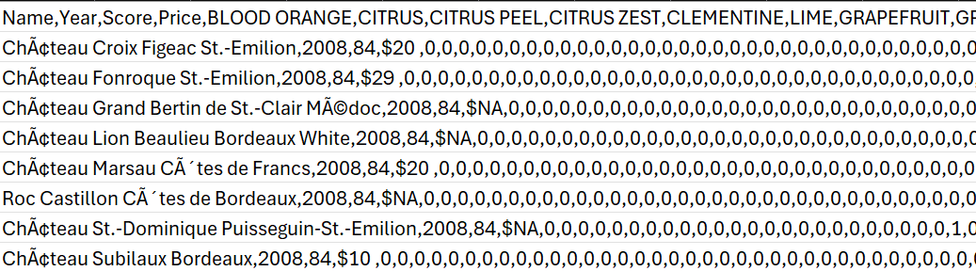
1. Dataset introduction
Bordeaux Wines
Over 800 features
14349 samples

Slide 5
2. Methods
Feature selection
Pearson correlation
Model building
First order Takagi-Sugeno-Kang
ANFIS
Updates
Parametrs tunning
Embedded input data
Results
MSE
VAF
Graphical representation
Clustering
C-Means
HDBSCAN
Gustafson-Kessel

Slide 6
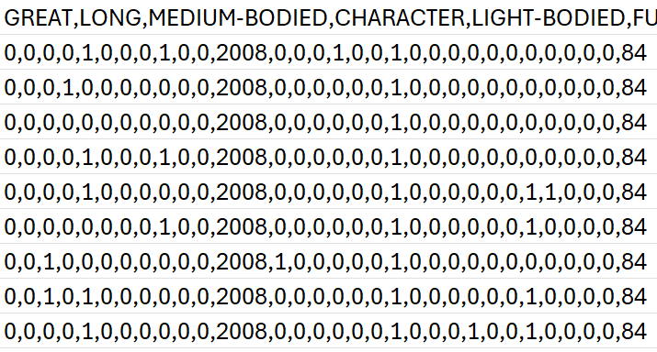
3. Features selection
Pearson correlation
30 features with highest absolute correlation

Slide 7
4. Results
Data Input | Clustering Method | TKS-1 | ANFIS
Original | C-Means | ✓ | ✓
 | HDBSCAN | ✓ | ✓
 | GK | ✓ | ✓
Embedded | C-Means | ✓ | ✓
 | GK | ✓ | x

Slide 8
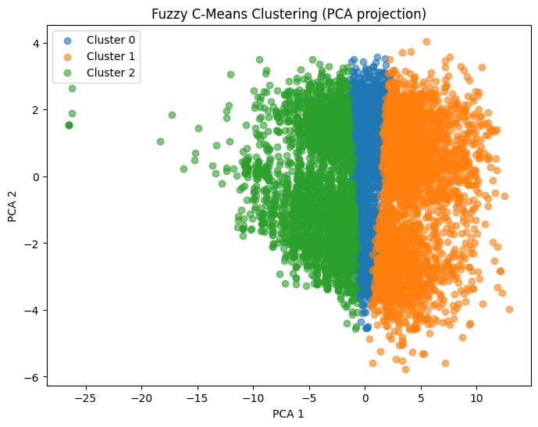
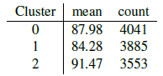
4.1 Original Data
C-Means clustering

Slide 9
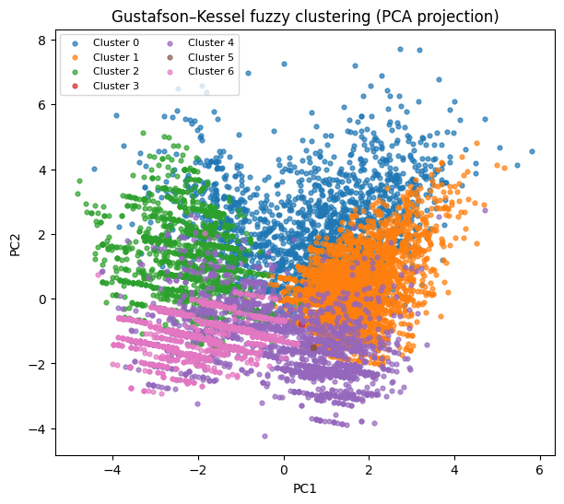
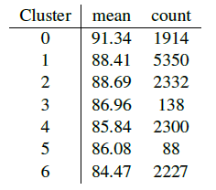
4.2 Original Data
GK clustering

Slide 10
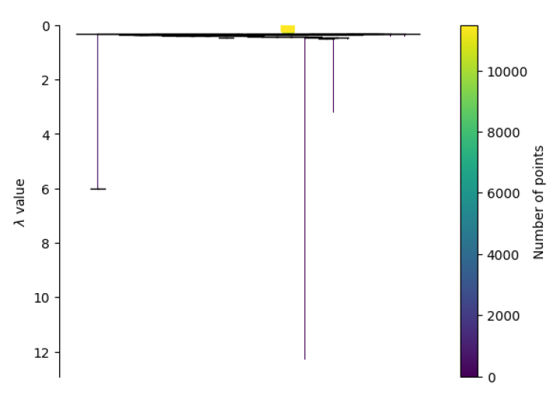
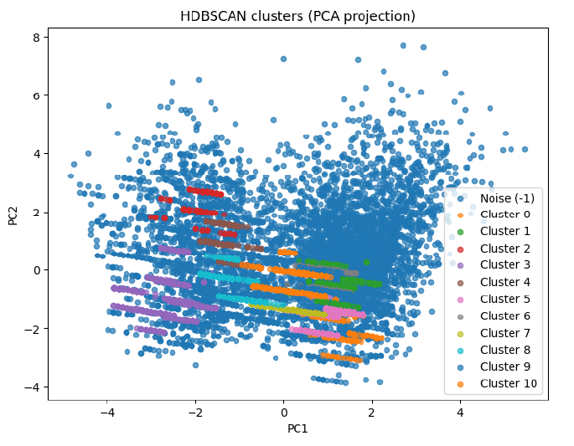
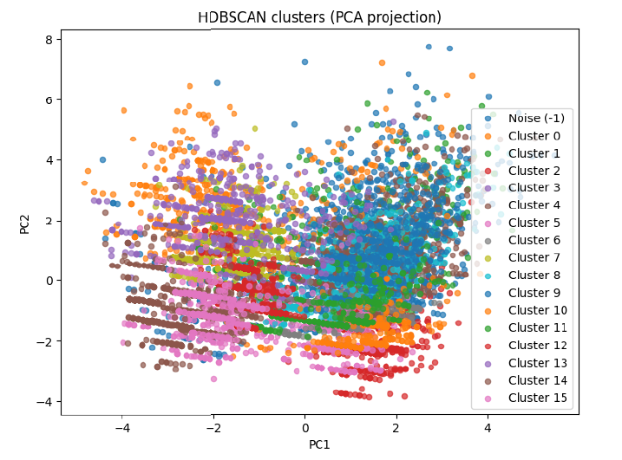
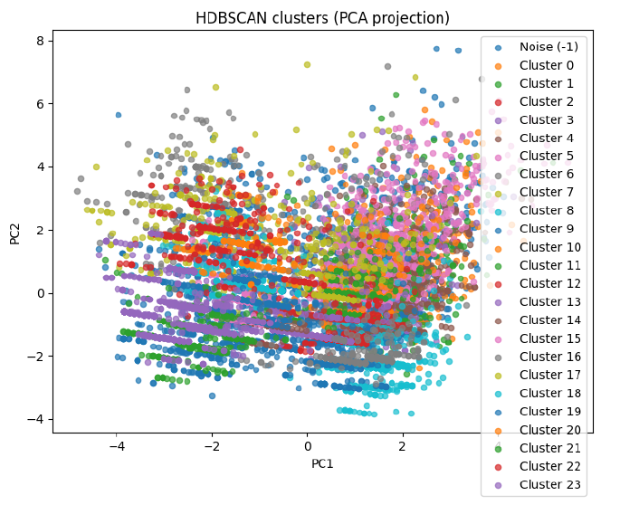
4.3 Original Data
HDBSCAN

Slide 11
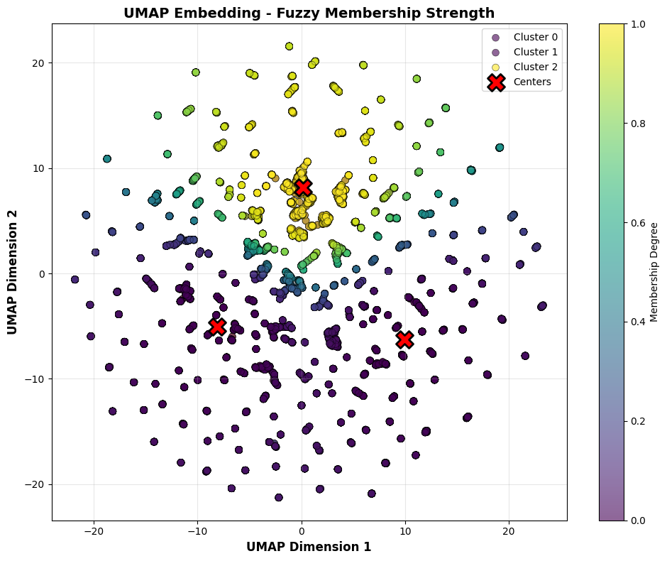
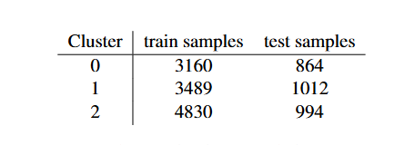
4.4 Embedded Data
C-Means

Slide 12
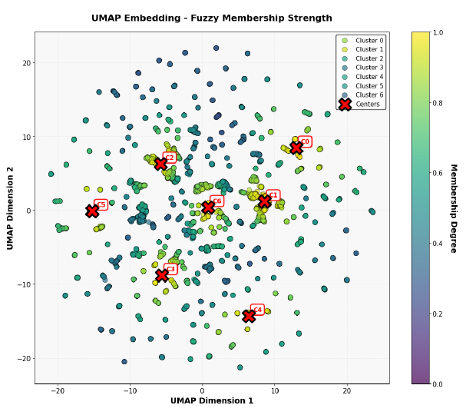
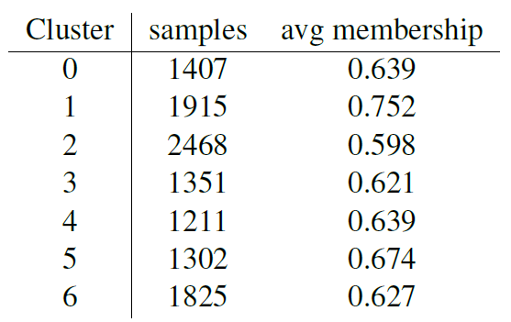
4.5 Embedded Data
GK clustering

Slide 13
4.6 Model performance
MSE | Clustering Method | TKS-1 | ANFIS
Original | C-Means | 767,04 | 573,33
 | HDBSCAN | 7709,90 | 7709,90
 | GK | 1892,95 | 3192,10
Embedded | C-Means | 10,93 | 10,91
 | GK | 9,96 | 9,99

Slide 14
4.7 Model performance
VAF | Clustering Method | TKS-1 | ANFIS
Original | C-Means | -5995,62% | -4764,83%
 | HDBSCAN | -0,00% | -0,00%
 | GK | -10092,89% | -7634,93%
Embedded | C-Means | -12,03% | -12,21%
 | GK | 17,61% | 17,63%

Slide 15
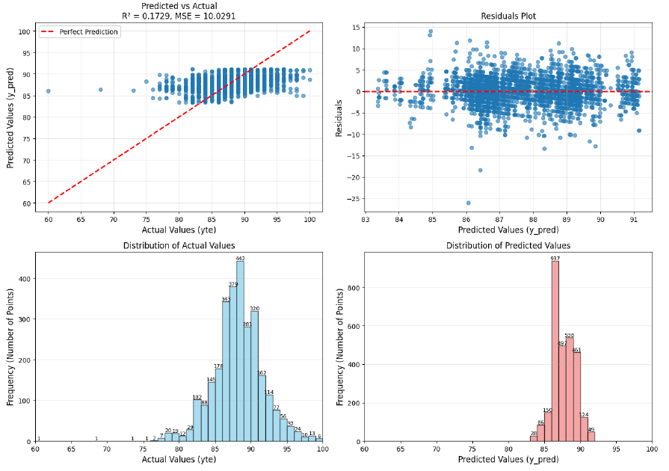
5. Conclusion
Best model performance was the embedded.
Models were biased to high scores because of the feature selection (reduced dataset).

Slide 16
Further Work
In future work, the correlation should also take into account the correlation of different features, as certain combinations may provide more meaningful insights than individual variables alone.
Creation of the classification
Will be picked up as a individual project by Tomas Kalina

